Slide 1


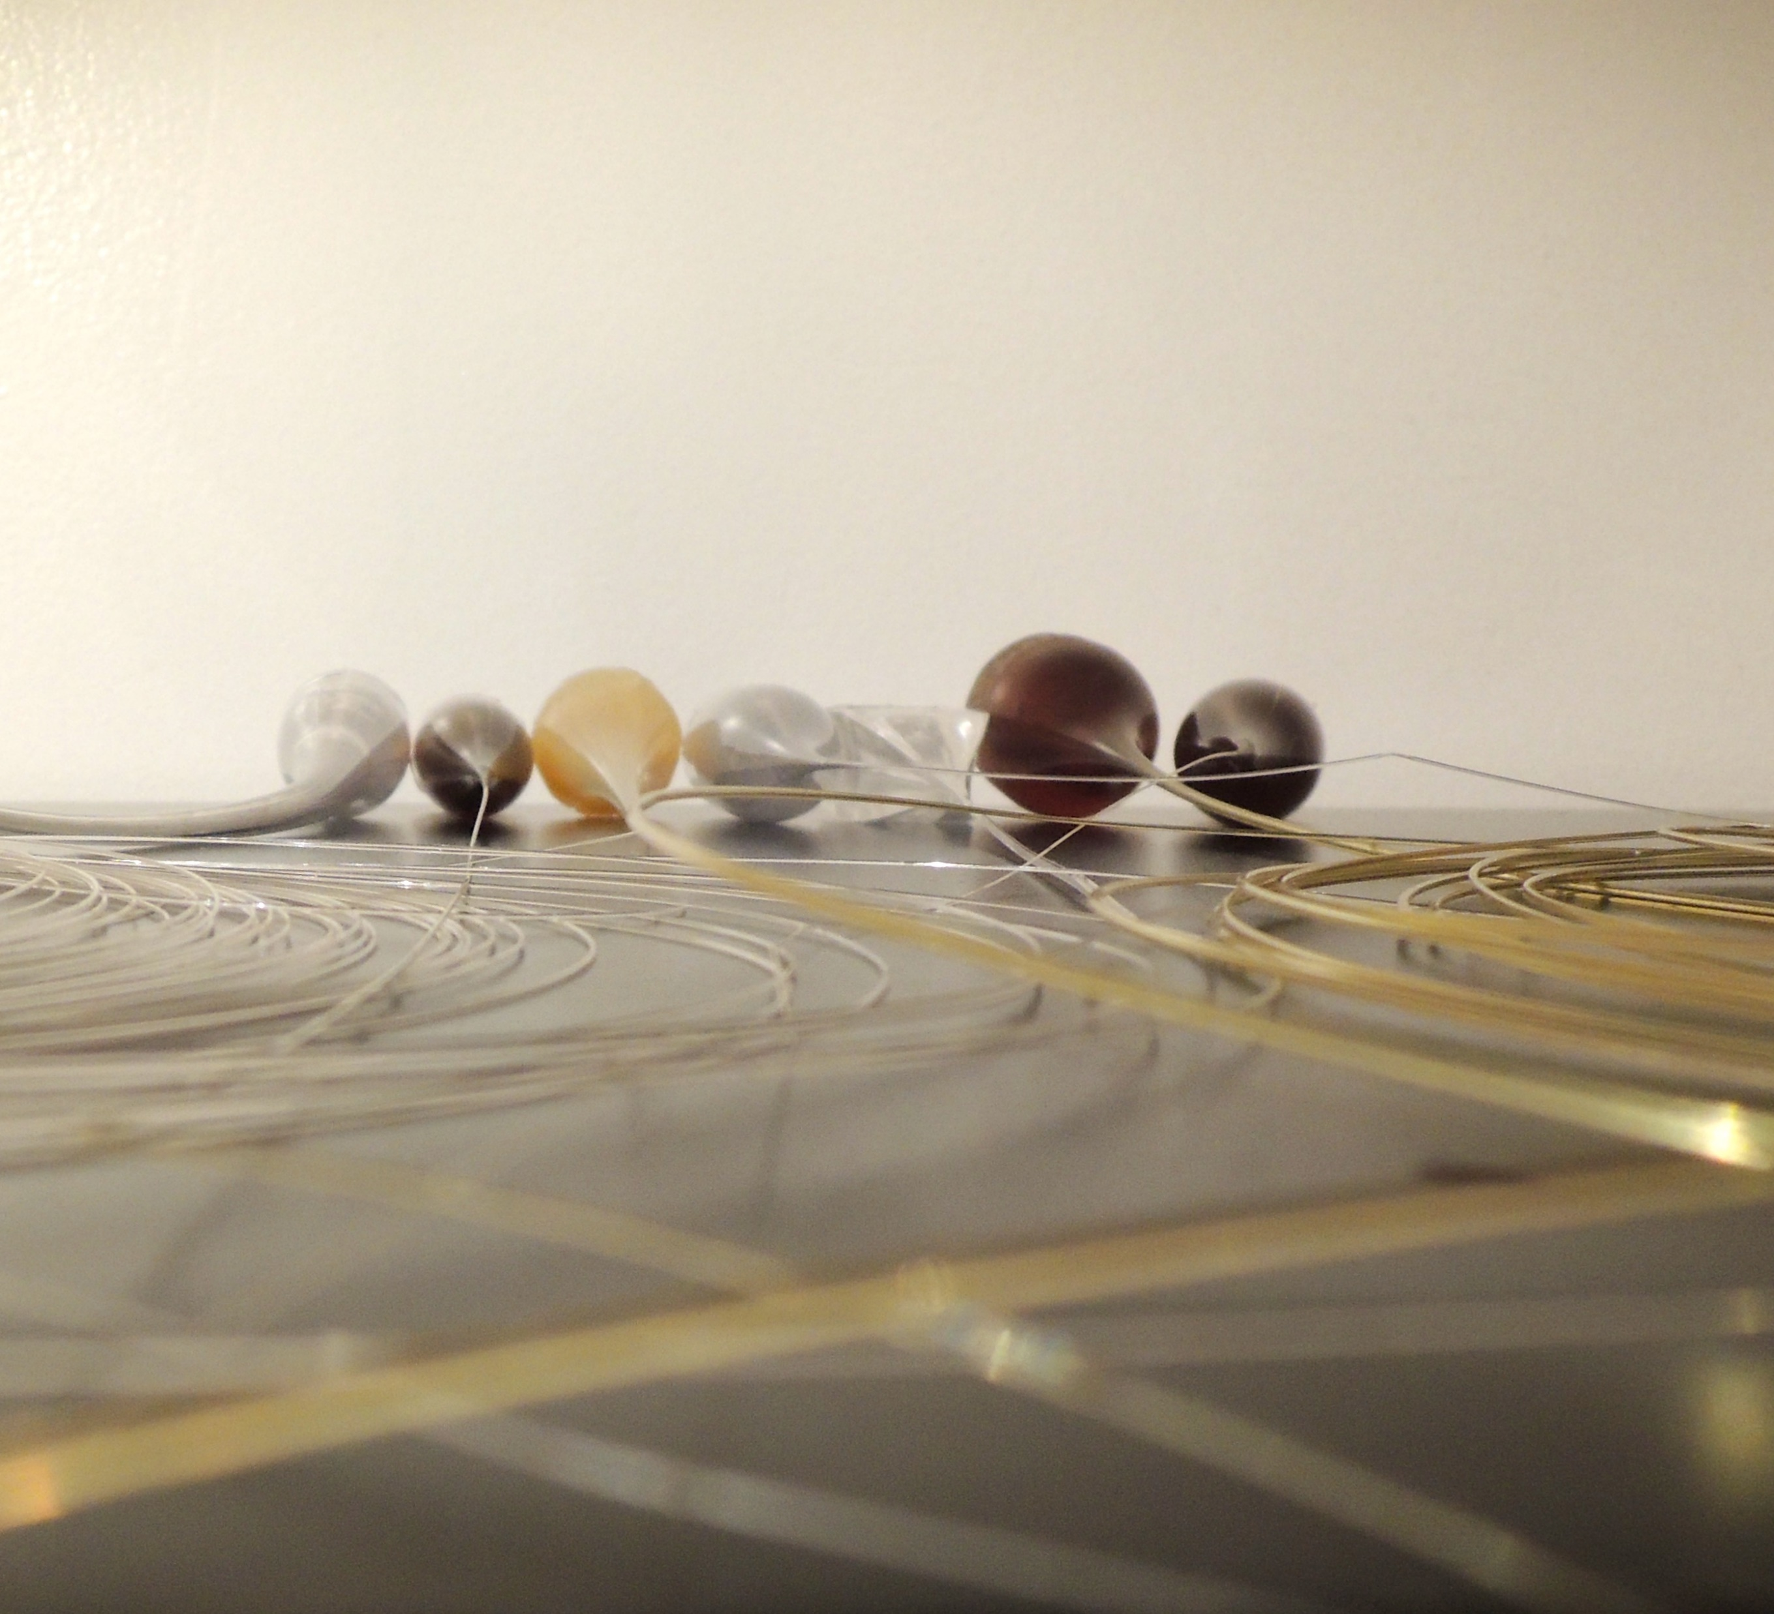
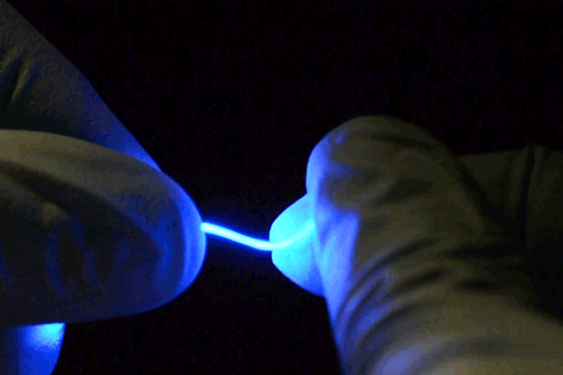
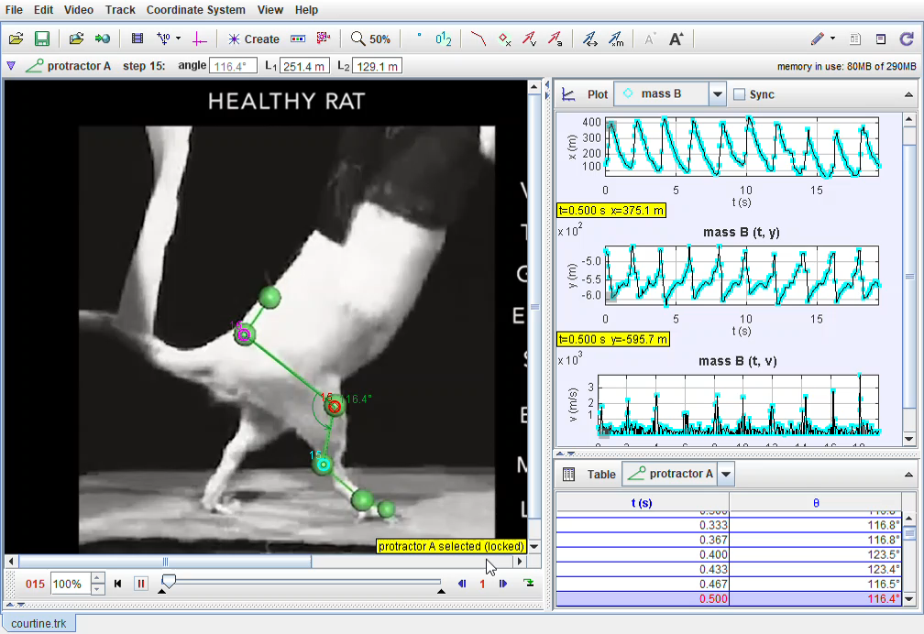
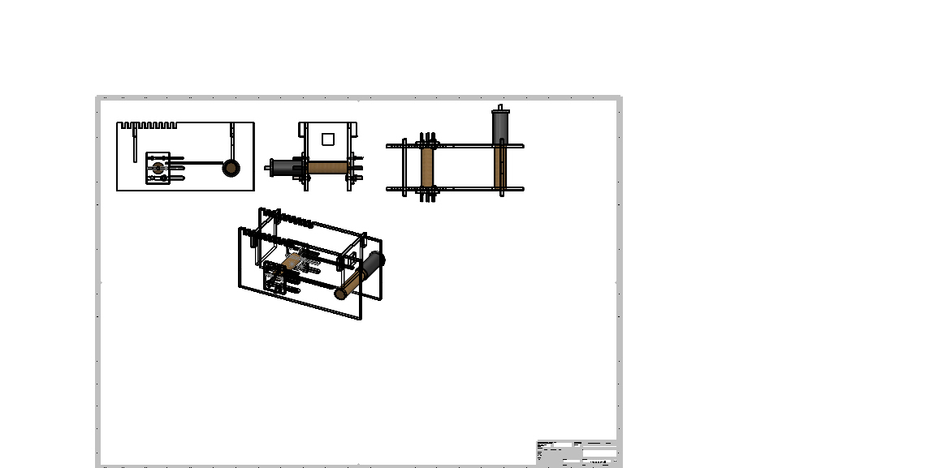
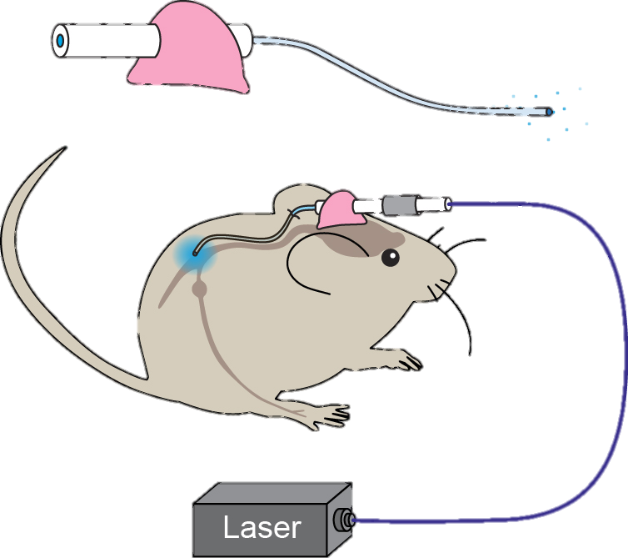
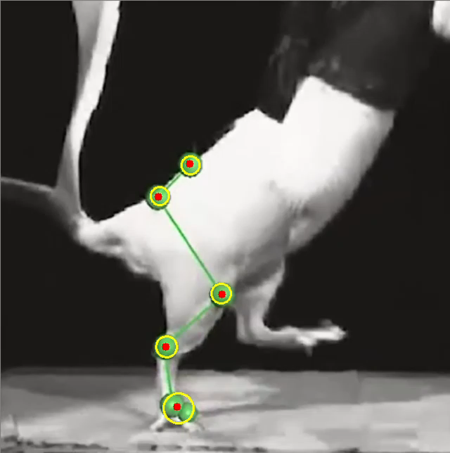
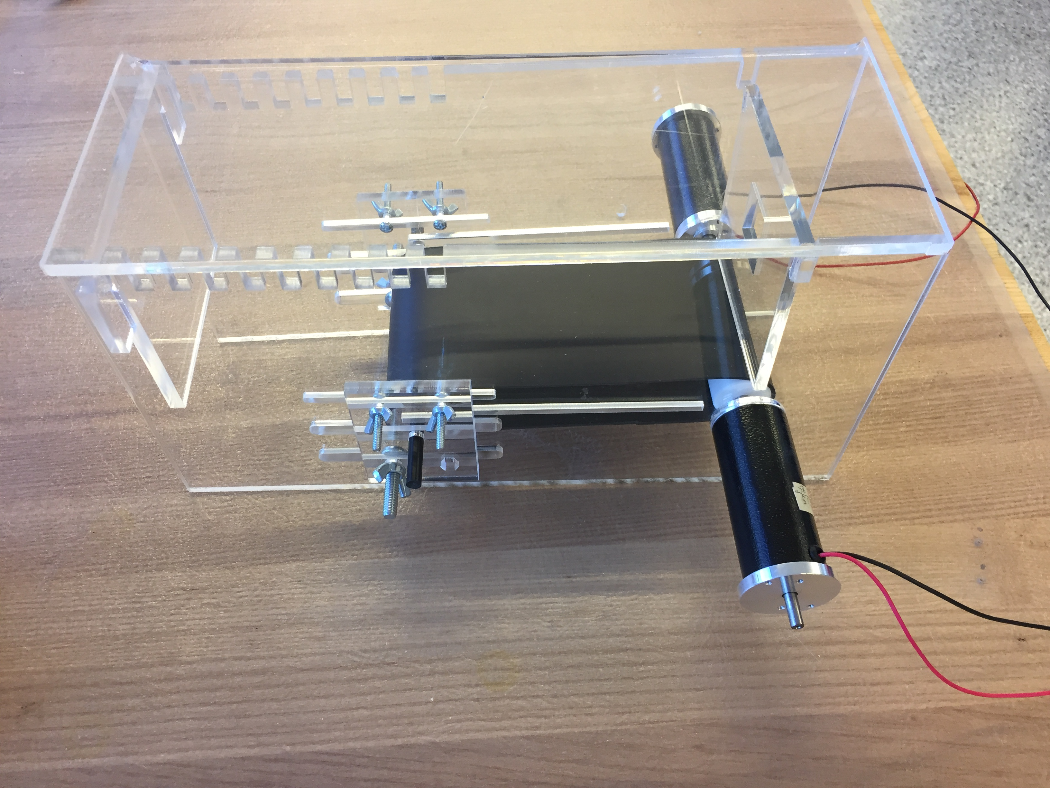
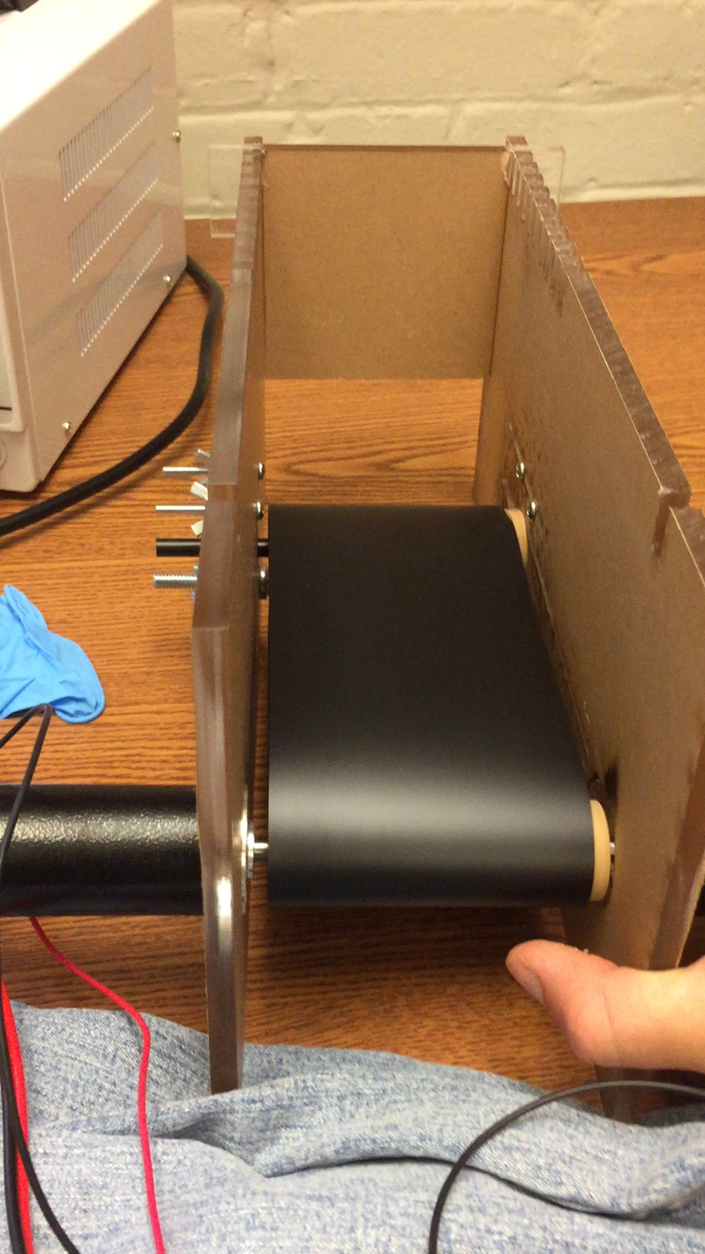
OPTICALLY STIMULATED NERVE REGENERATION IN SPINAL CORD
Haley O. Higginbotham^{1,2}, Dena Shahriari², Polina Anikeeva²
¹ Johnson & Johnson UROP Scholars Program, ²Bioelectronics Group, MIT, Cambridge MA, 02139
INTRODUCTION
The Bioelectronics Group has developed flexible neural probes for stimulating and recording neural activity. These probes are capable of delivering electrical, chemical, and optical stimuli to the spinal cord and peripheral nervous system. Due to their soft, flexible nature, the implanted probes significantly reduce tissue damage when compared to clinically approved neural probes. This UROP project involves analyzing the efficacy of optical stimulation, via these probes, for regeneration of the spinal cord in mice.
ABSTRACT
We are interested in studying the effects of optical stimulation on nerve regeneration in the spinal cord. Towards this end, a spinal cord injury will be induced in an optogenentically active strain of mice. A treadmill task will be used to assess the timescale and extent of recovery of locomotor function post-injury. The treadmill task will be video-recorded and these videos will be analyzed using a custom made motion capture script to obtain parameters of the motion. We predict that this data will reveal greater recovery of locomotor function in the optically stimulated mice, thereby suggesting greater nerve regeneration in these mice.
FUTURE STEPS
Train mice on treadmill so they become accustomed to it
Surgically induce spinal cord injury & implant fiber
Stimulate site of injury optogenetically via implanted fiber
Obtain neural recordings via the fiber at various timepoints during recovery
Record video of treadmill task at various timepoints during recovery
Pass treadmill videos through motion capture software for analysis
Draw conclusions about optical stimulation’s effects on nerve regeneration in mouse model with induced spinal cord injury
REFERENCES
THE PROCESS
Software
Search for existing Motion Capture Software
Develop custom script in Python
Hardware
1. Design treadmill in Solidworks
2. Create the parts
3. Assemble & test
4. Repeat steps 3-5 ad infinitum
Ctrl + click for video
STATUS REPORT
To date, the platform for assessing regeneration (treadmill and motion capture software) has been developed.
The next steps in the project include training the mice on the treadmill, surgically inducing spinal cord injury and implanting the fiber, and assessing regeneration at various timepoints in the recovery process.
ACKNOWLEDGEMENTS
Special thanks to the Johnson & Johnson program for funding this amazing research experience and providing valuable mentorship and workshop opportunities. I would also like to thank Dr. Dena Shahriari for being an exceptional research mentor.
Notes:
Previous studies have studied nucleosome sensitivity in yeast and maize
This is one of first on human cells

